Slide 1
Wi-Find

Slide 2
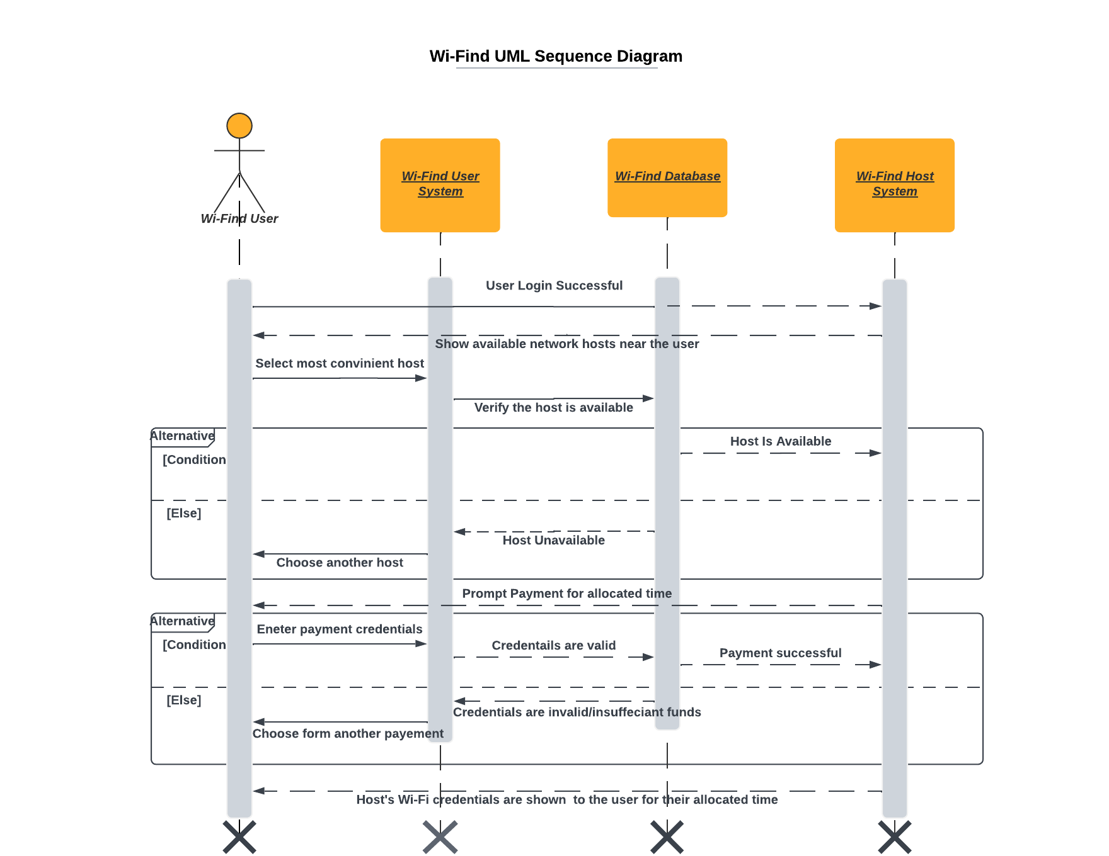
UML Sequence Diagram

Slide 3
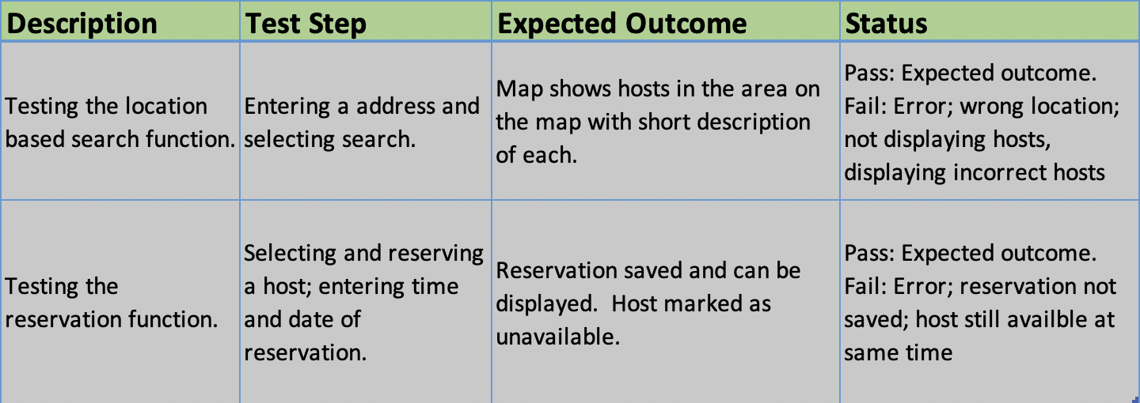
Test Cases

Slide 4
User Activity Abstract
The abstract lays out the generalized process for the user activity
In the diagram technical steps are left out as its purpose is to model the user thought process or environment

Slide 5
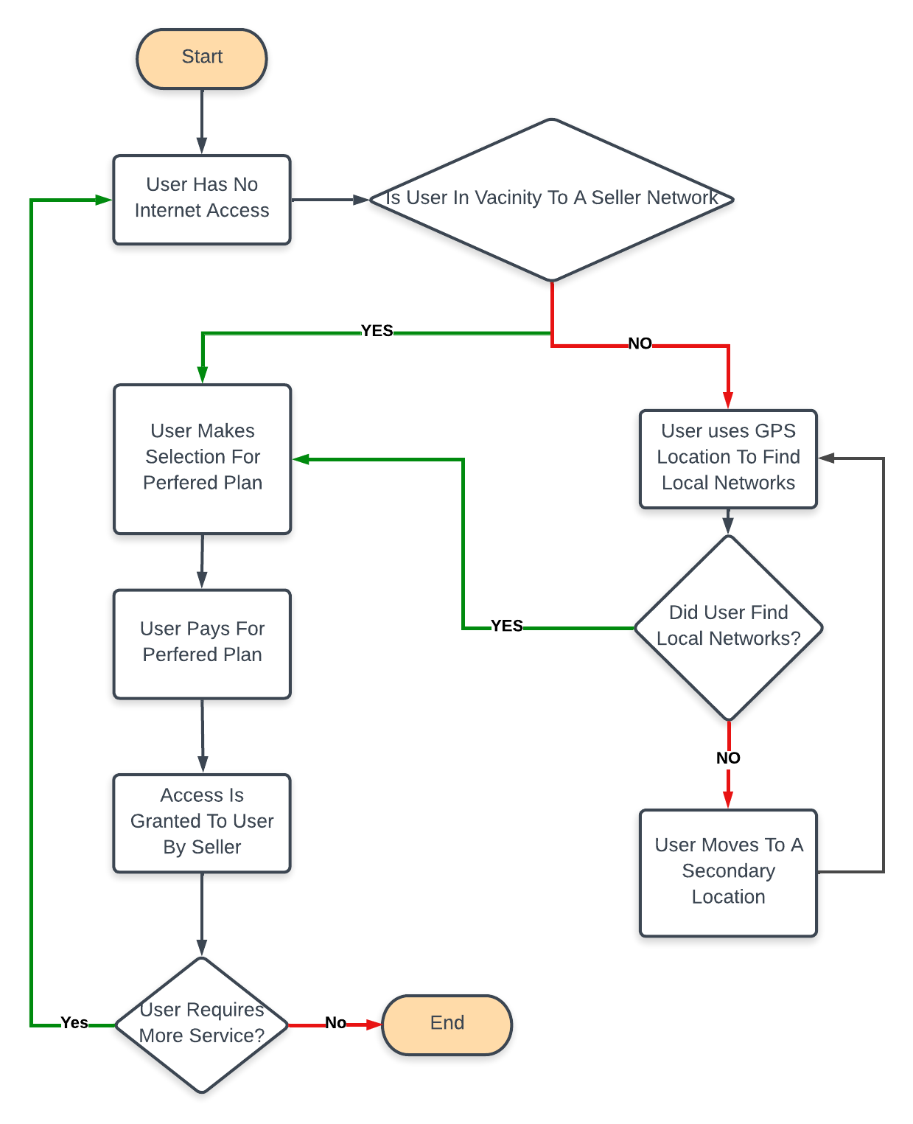

Slide 6
The User Activity With System
It is the purpose of the diagram to depict the users technical interactions with the software
This includes certain states the software will be in depending on the users interactions

Slide 7
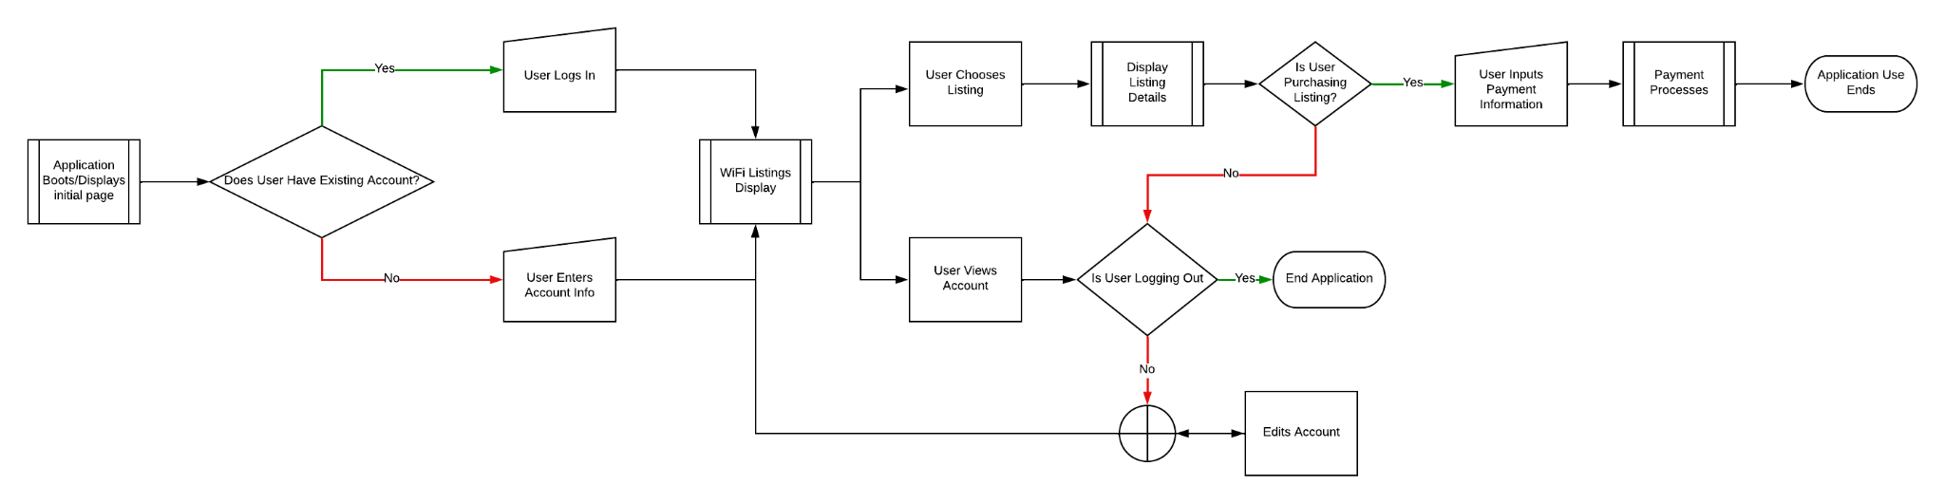

Slide 8
